Slide 1
Software Engineering CS20006
Lecture 19
Project Planning

Slide 2
Lecture #19
Software Project Planning
SPMP Documentation
System Design Models

Slide 3
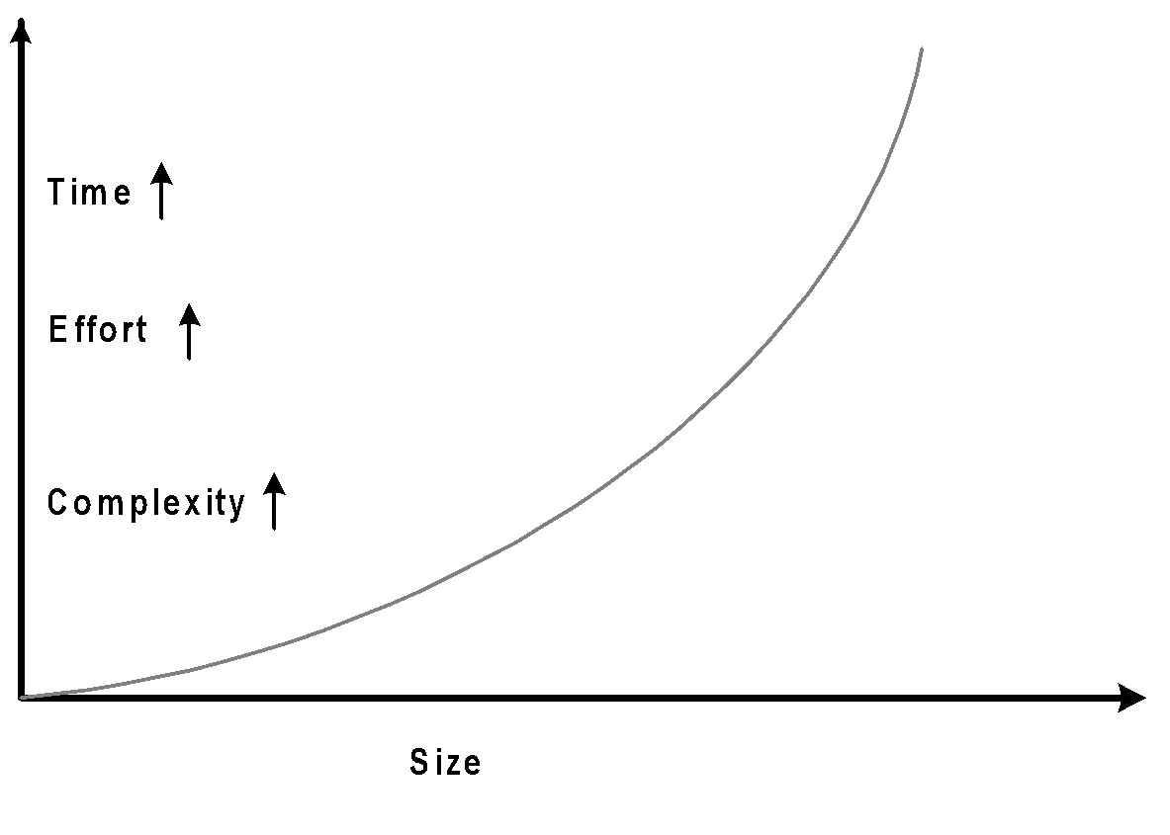
Why Planning Software Project?
Program vs. Software
Size (small/big)
Effort (Individual/Team)
Application and user
Reliability (testing)
Documentation (manual)
Technological growth
Hardware
Software
Communication
IT based society

Slide 4
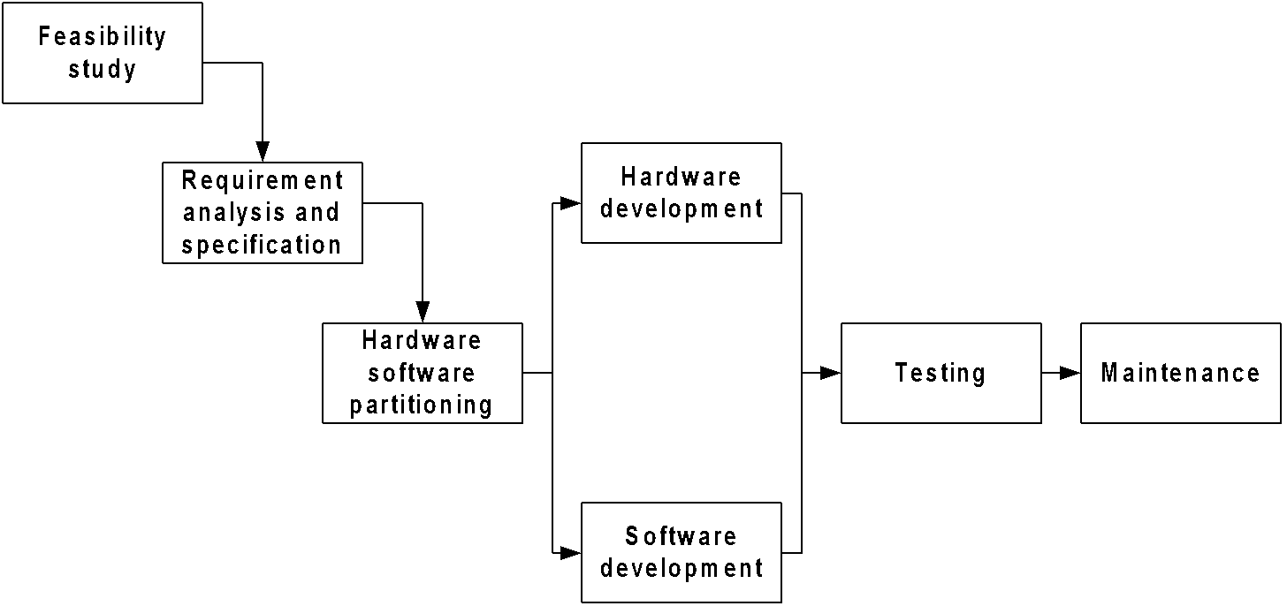
Software Engineering

Slide 5
Project Management
Crucial things to the success of any project
Enables a team to work efficiently
Distribute work load
Pipelining the productivity
Project planning
After the feasibility study (FS) and requirement analysis and specification (RAS)
Responsibility of the Project Manager

Slide 6
Activities in Project Planning
Estimating some basic attributes of project
Cost
Duration
Effort
Scheduling manpower and other resources
Staff organization and staffing plans
Risk identification, analysis, and abatement planning
Quality assurance plan, configuration management planning

Slide 7
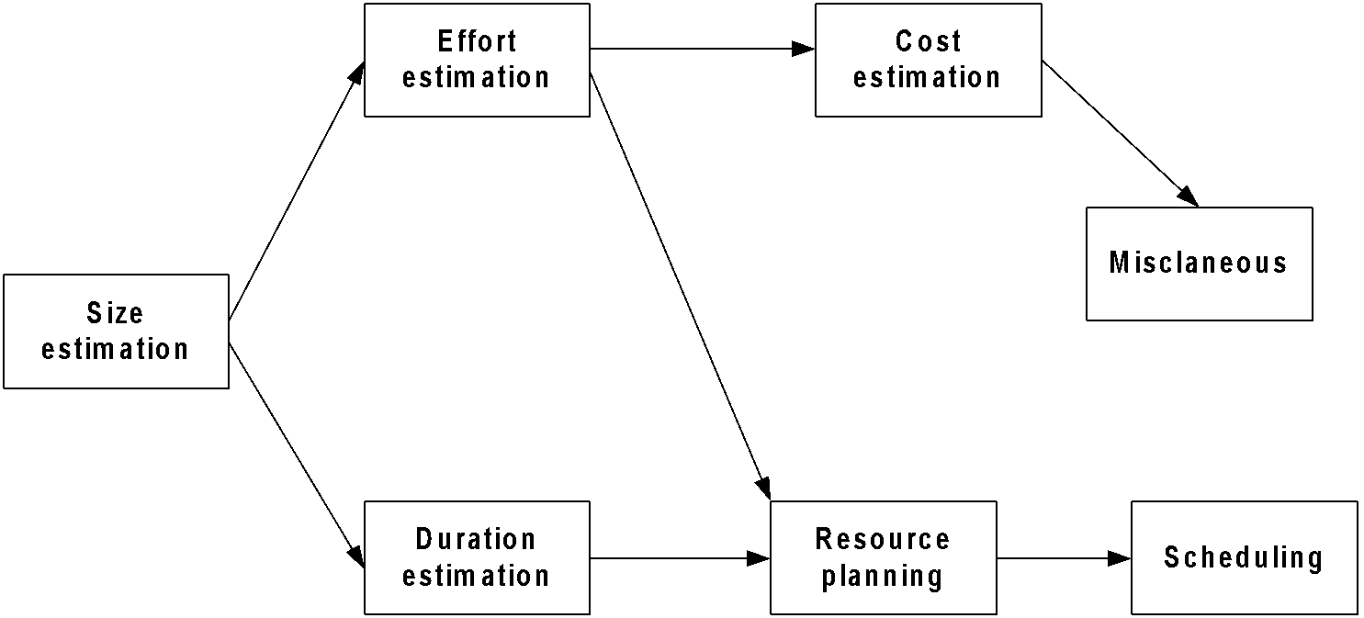
Activities in Project Planning

Slide 8
Software Project Management Plan
SPMP documentation
Items to be documented:
Introduction
Project Estimates
Schedule
Project Resources
Staff organization
Risk Management Plan
Project Tracking and Control Plan
Miscellaneous plan

Slide 9
SPMP Document Template
Introduction
Objective
Major Functions
Performance Issues
Management and Technical Constraint
Project Estimates
Historical Data Used
Estimation Techniques Used
Effort, Resource Cost, and Duration Estimation

Slide 10
SPMP Document Template
Schedule
Work Breakdown Structure
Task Network Representation
Gantt Chart Representation
PERT Chart Representation
Project Resources
People
Hardware
Software
(d) Communication Support

Slide 11
SPMP Document Template
Staff organization
Team Structure
Management Reporting
Risk Management Plan
Risk Analysis
Risk Identification
Risk Estimation
Risk Abatement Procedures
Project Tracking and Control Plan

Slide 12
SPMP Document Template
Miscellaneous plan
Process Tailoring
Quality Assurance Plan
Configuration Management Plan
Validation and Verification
System Testing Plan
Delivery, Installation and Maintenance Plan

Slide 13
System Design Models

Slide 14
System Design Models
System Design Life Cycles
Waterfall Models
Classical Waterfall Model
Iterative Waterfall Model
Prototyping Model
Evolutionary Model
Spiral Model
Rapid Application Development
Component-Based Software Engineering

Slide 15
? System Design Life Cycle
A system design life cycle is a process consists of set of methodologies (activities) beginning from system inception through delivery and retirement
Basic activities in a system design life cycle are:
Feasibility study
Requirement analysis and specification
Design
Coding
Testing
Maintenance
An activity is also alternatively termed as a life cycle phase

Slide 16
? System Design Life Cycle
A system design life cycle can be modeled with descriptive and diagrammatic representation representing:
All activities required to make a software product transit through its life cycle phases
Order in which activities are to be undertaken
Number of life cycle models are known to system designers
All models are same so far the basic activities are concerned
Models are different so far the order of activities are concerned

Slide 17
Why a Life Cycle Model?
It encourages development of system in systematic and disciplined manner
Provides better understanding and communication among team members
Pipelining the activities to carried out number of dissimilar projects together
Better utilization of resources (human + system)

Slide 18
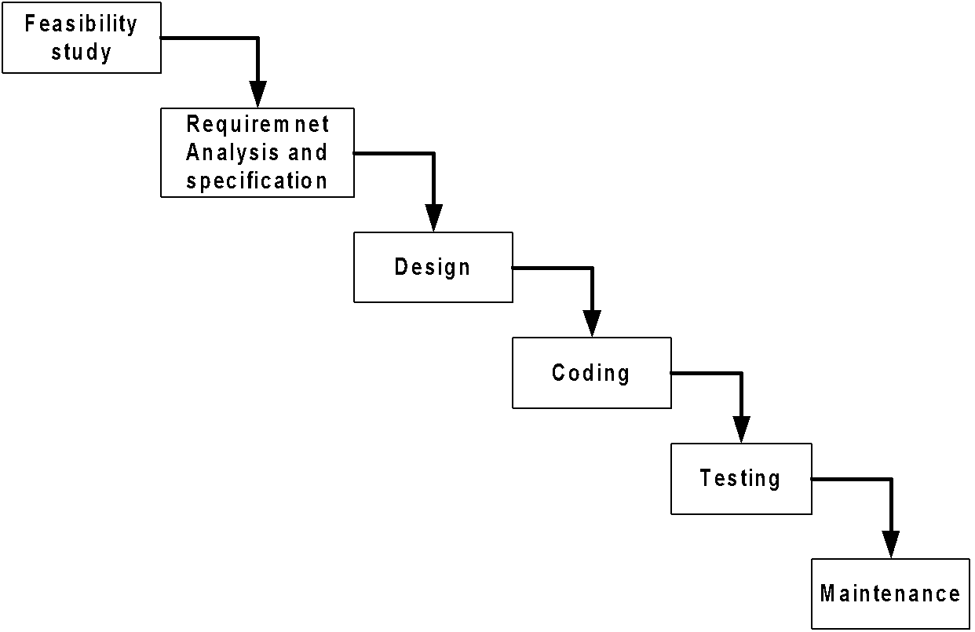
Classical Waterfall Model

Slide 19
Classical Waterfall Model
The classical waterfall model is an elegant and intuitively the most obvious way to develop system
The model is considered to be theoretical way of developing system
Rather the model is not practical
Other life cycle models are essentially derived from the classical waterfall model

Slide 20
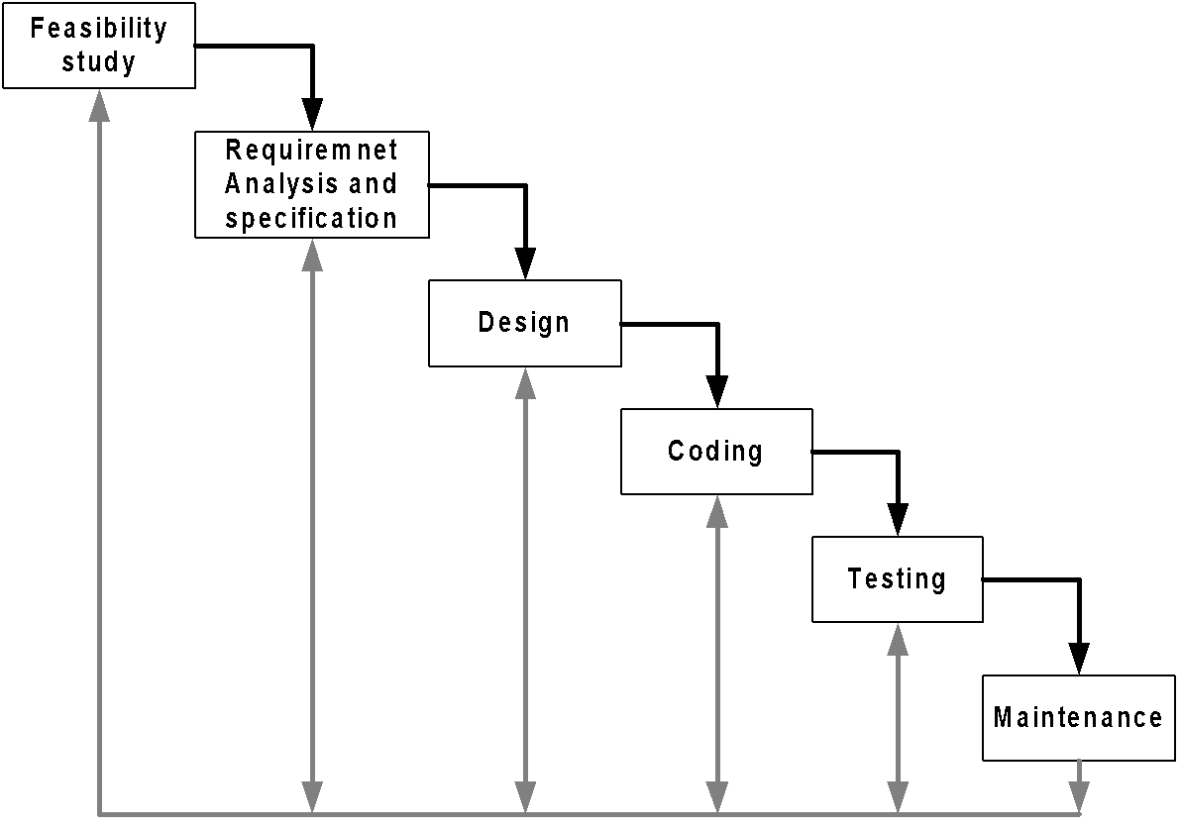
Iterative Waterfall Model

Slide 21
Iterative Waterfall Model
Advantages:
Iterative waterfall model is practical compared to the classical waterfall model since errors are taken into consideration in it
Drawbacks
It unable to handle different risks that a real-life software project is subjected to
It follows rigid phase sequence, but for higher productivity and better efficiency it may not be desirable at all
The model is suitable for well-understood problem, not suitable for very large projects

Slide 22
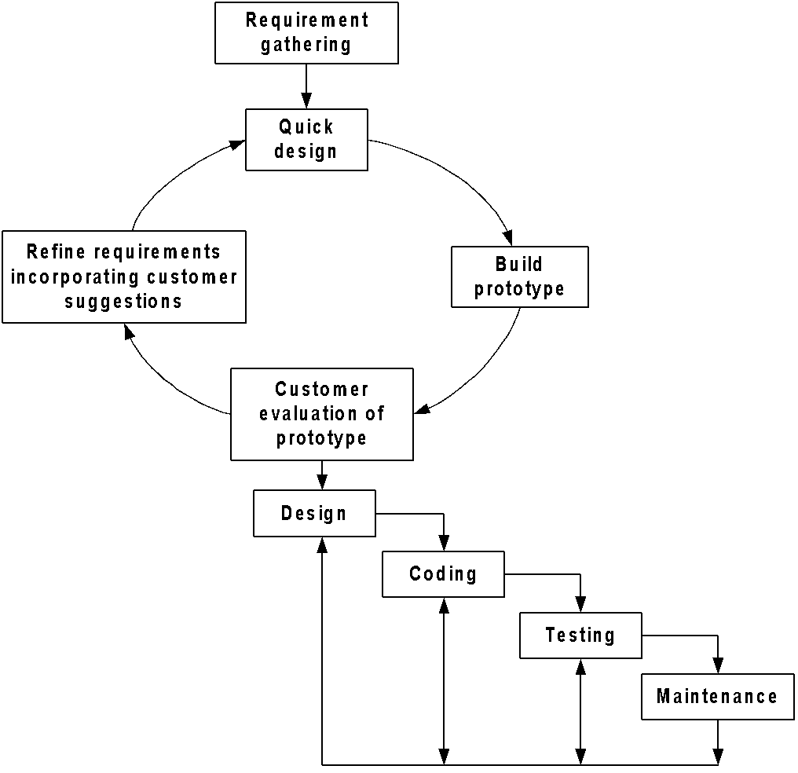
Prototyping Model

Slide 23
Prototyping Model
Expensive but deal with more complex and new system development (unlike waterfall model)
Many customer requirements get properly defined
Technical issues get resolved by experimenting with the prototype
Minimizes the redesign costs

Slide 24
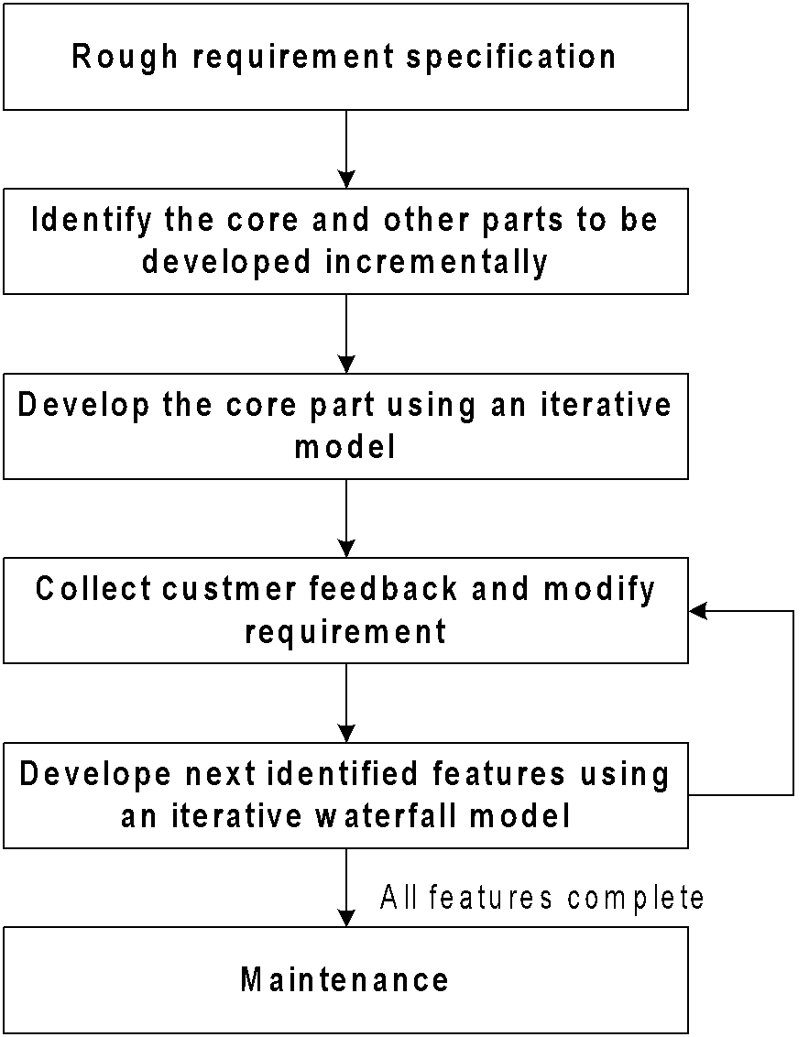
Evolutionary Model

Slide 25
Evolutionary Model
This model is based on the incremental approach
User gets a chance to experiment with a partially developed system much before the complete version
Minimum redesign effort
Obviate the need to commit large resources in one go
Suitable for very large system development

Slide 26
Spiral Model
Spiral model is also termed as meta model, since it subsumes all the previously discussed models
Unlike other models, it provides good insight to the project risks
Spiral model is much more flexible compared to other models

Slide 27
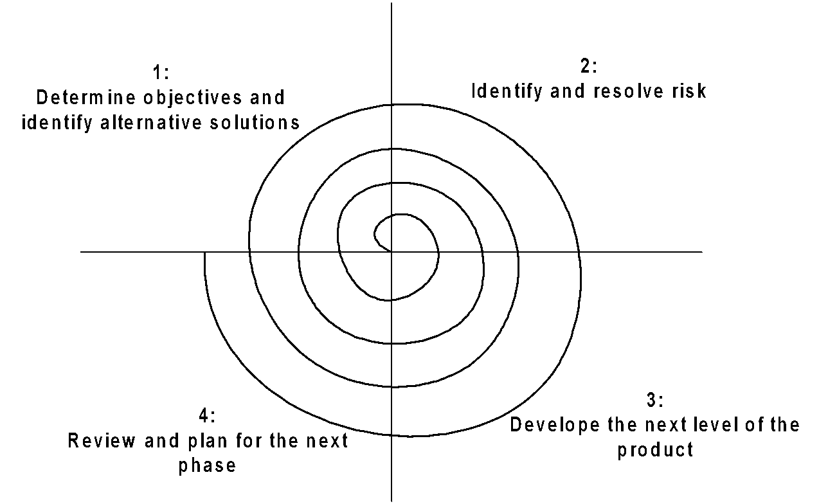
Spiral Model

Slide 28
Spiral Model: Salient Features
Models looks like a spiral with many loops
The number of loops is not fixed rather decided by
Number of phases
Iteration of the phases
Exact number of phases and order of phases is not fixed hence the model is more flexible
There are four stages of each phase, which is depicted by four sectors in the model
As a loop proceeds, a more complete version of the system gets build
Radius of spiral at any point represents the cost incurred in the project till then
Angular dimension represents the progress made in the current phase

Slide 29
Rapid Application Development
It is an objective-oriented approach to system development
RAD and Prototyping are conceptually very close
Goal of RAD is to shortening the time typically needed in a traditional SDLC
There are three phases in RAD
Requirement planning
Design
Implementation

Slide 30
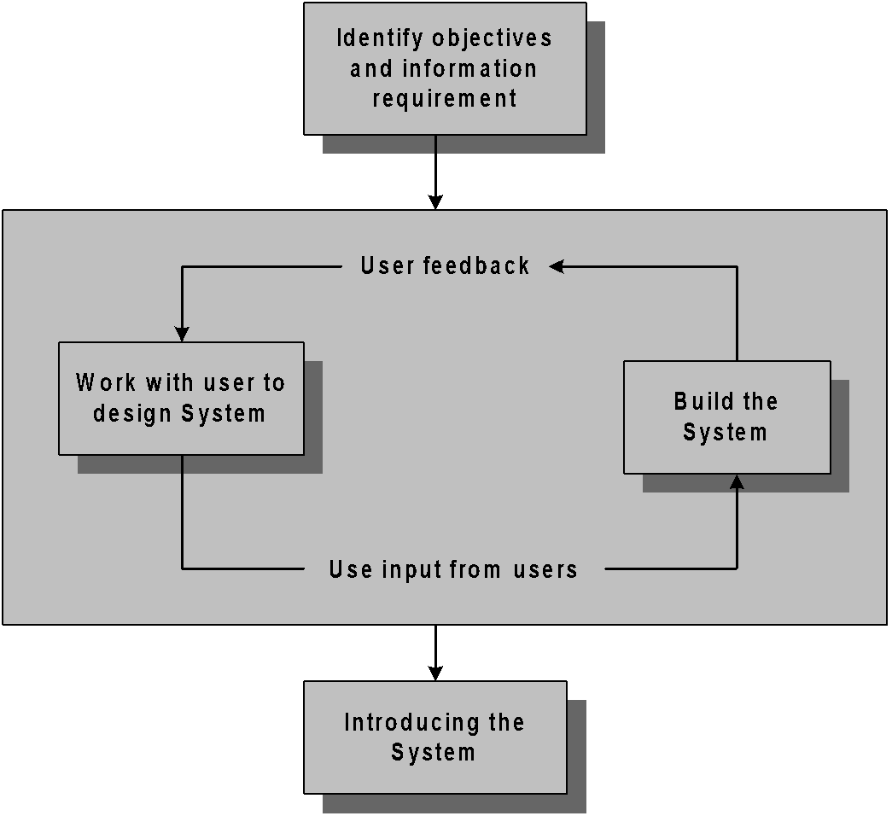
Rapid Application Development

Slide 31
Rapid Application Development
Advantages
Useful for inexperienced team
Pressing business for speeding up the system development
Working with novel system development
Developing system for sophisticated users
RAD can be merged with SDLC
Disadvantages
Not a systematic approach
Hardly bother about system documentation
Time vs. Attention trade-off

Slide 32
Component-Based Software Engineering
In majority of the software project there is some software reuse
Components which are readily available to a team can be modified them as needed and incorporated them into their system
Reuse is often essential for rapid system development
CBSE is a reuse-oriented approach
It follows a large base of reusable software components and some integrating framework for these components
These components are called COTS (Commercial Off-The-Shelf)

Slide 33
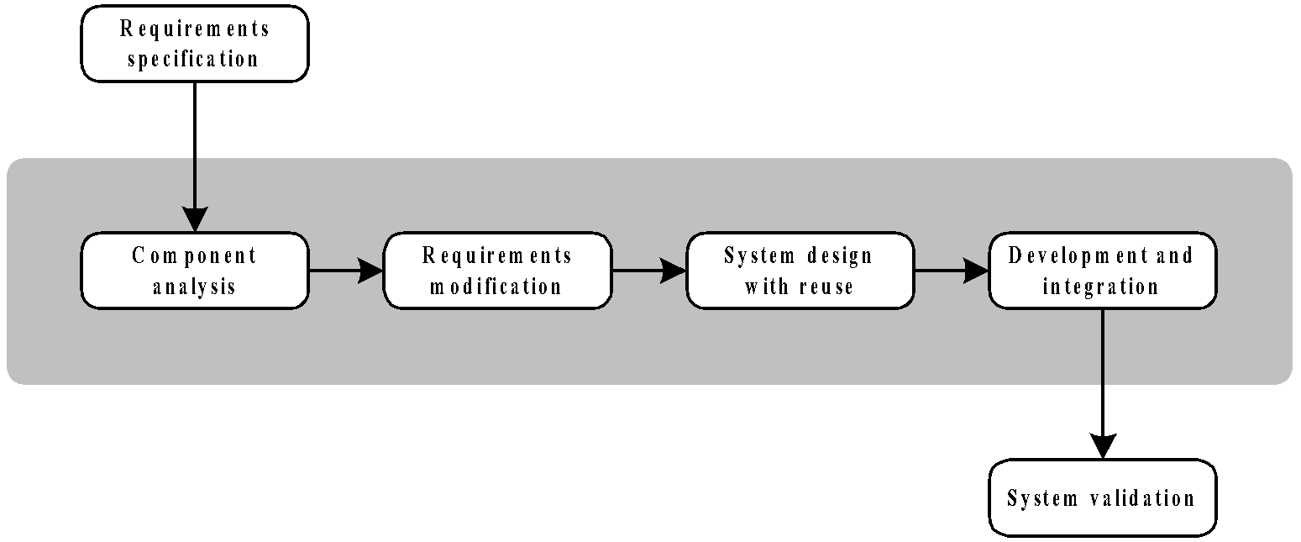
Generic Process Model of CBSE

Slide 34
Component-Based Software Engineering
Advantages
Reduces the amount of software to be developed
Reduces the cost of development
Reduces risk
Disadvantages
Requirement compromises are inevitable
May lead to a system that does not meet the real needs of users
Control over the system evolution is lost as the new versions of the reusable components are not under the control of the project group

Slide 35
Problems to Ponder
Which model is suitable for which system? List a few with justification.
Arrange the life cycle models in order according to
Development time
Redesign time (customer satisfaction)
Problem size
Cost
Why RAD is suitable for object-oriented system development?

